Slide 1
University of Basra College of medicine Department of pathology and forensic medicine The Male Genital Tract Dr. Zainab A. Ameen Iraqi board of histopathology and forensic medicine

Slide 2
References .Robbins and cotran pathologic basis of disease .www.pathologyoutlines.com. .www.webpathology.com.

Slide 3
Learning objectives . Most common pathological lesions . Prominent pathological features of those lesions

Slide 4
The Penis 1. Congenital anomalies 2. Inflammation 3. Tumors

Slide 5
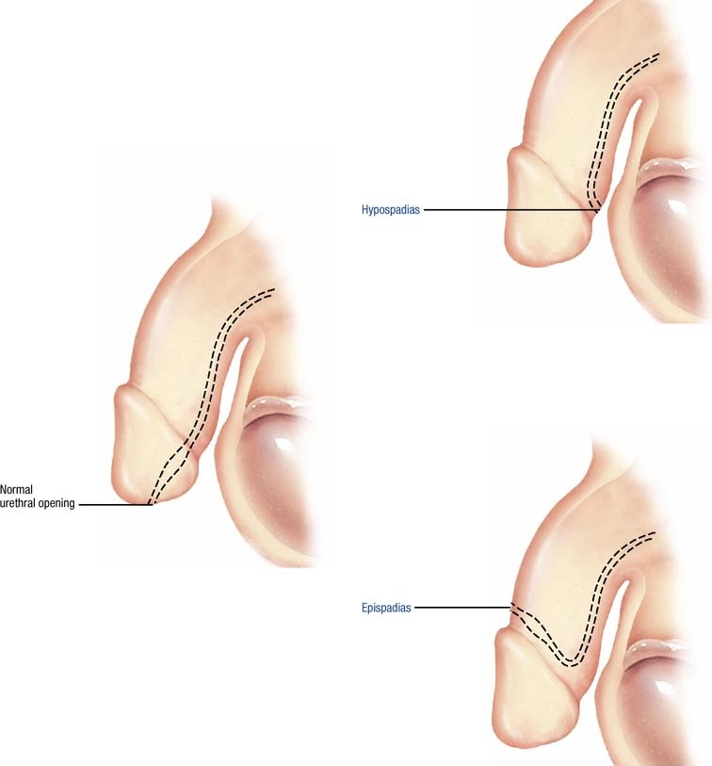
Congenital anomalies 1.Hypospadias and Epispadias . Abnormal urethral opening either into the ventral surface of the penis (hypospadias), or the dorsal surface (epispadias) . They are associated with increased risk of urinary tract infection.

Slide 6
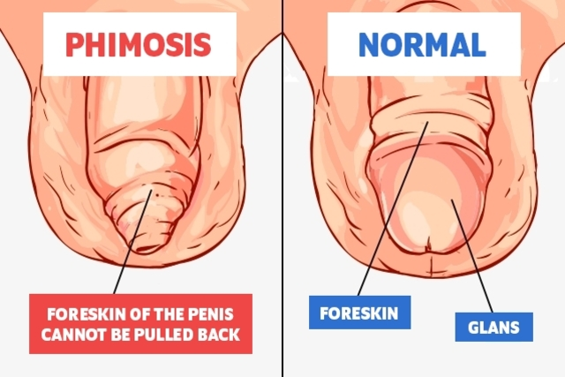
2. Phimosis . A condition in which the prepuce is too small to permit normal retraction behind the glans penis . Developmental or acquired

Slide 7
Inflammation . Almost invariably involve the glans and prepuce and include variety of specific and nonspecific infections . Most cases are the result of poor local hygiene in uncircumcised male . Persistent infection end in scarring and phimosis

Slide 8
Tumors .Tumors of the penis are uncommon .The most common are carcinoma and condyloma accuminatum Benign tumors . Condyloma accuminatum . Sexually transmitted disease caused by human papilloma virus ( HPV type 6 and 11),occur on the external genitalia or the perineal area , and tend to recur.

Slide 9
Morphology Grossly: single or multiple , sessile or pedunculated , red papillary growth Microscopically: branching , villous , papillary connective tissue stroma covered by epithelium that show acanthosis and hyperkeratosis, with koilocytosis

Slide 10
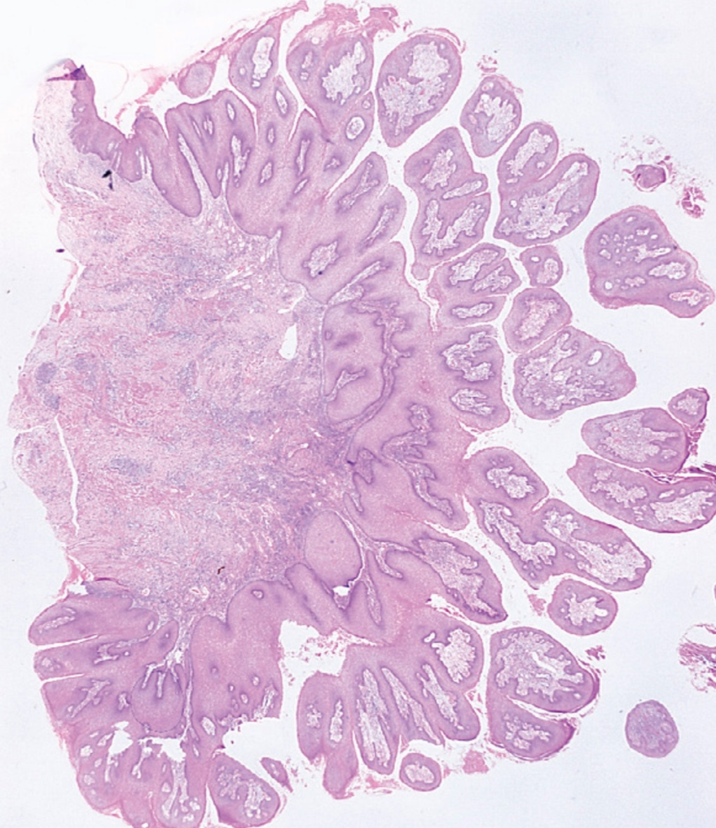
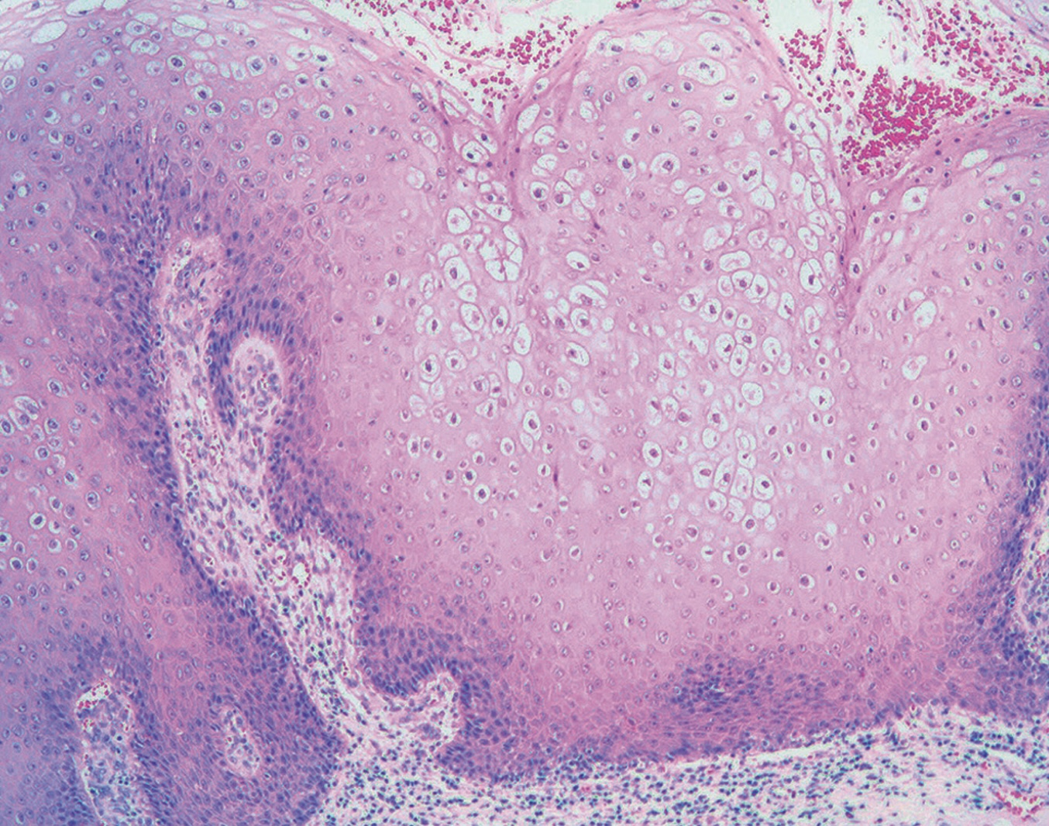
Condyloma accuminatum

Slide 11
Malignant tumors 1.Carcinoma in situ (Bowen's disease): It tend to involve the shaft of the penis and scrotum Morphology Grossly: solitary thickned grey - white opaque plague , when involving the glans, it apear as single or multiple shiny red velvety plaques.

Slide 12
Microscopically: epidermal hyperplasia with marked dysplasia and numerous mitosis, some of which is atypical, the cells are hyperchromatic and loss of the orderly maturation, the basement membrane is intact. Bowen's disease is a premalignant condition , 10 % of cases transform into invasive squamous cell carcinoma

Slide 13
2.Squamous cell carcinoma: .Rare .40-70 years .Risk factors: -poor genital hygiene -HPV type 16 and 18 . Circumcision confers protection .Slowly growing ,non painful ,locally invasive lesion .Early inguinal lymph nodes metastasis and rare distant metastasis

Slide 14
Morphology Grossly: papillary or flat lesion on the glans or prepuce Microscopically: usually moderately differentiated with keratinization

Slide 15
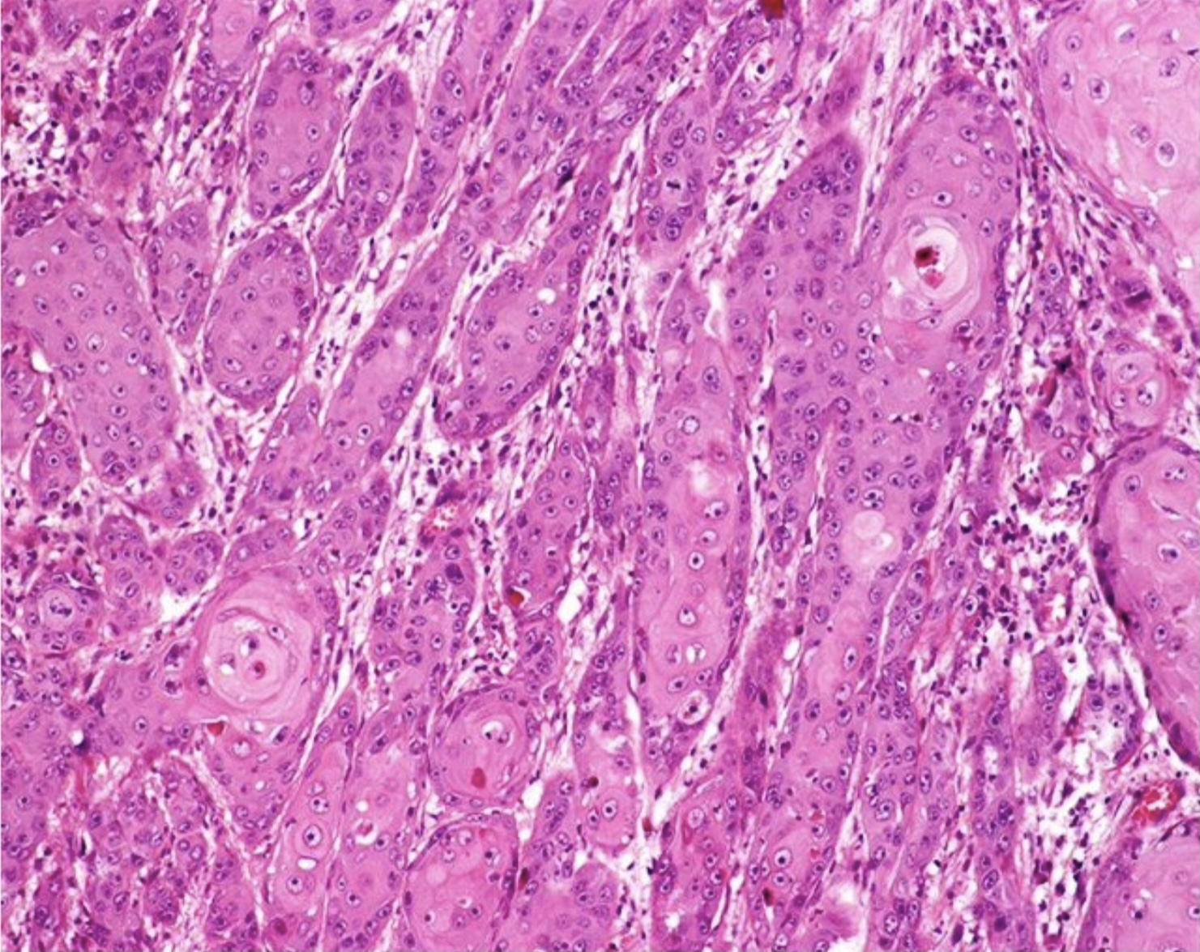
Squamous cell carcinoma

Slide 16
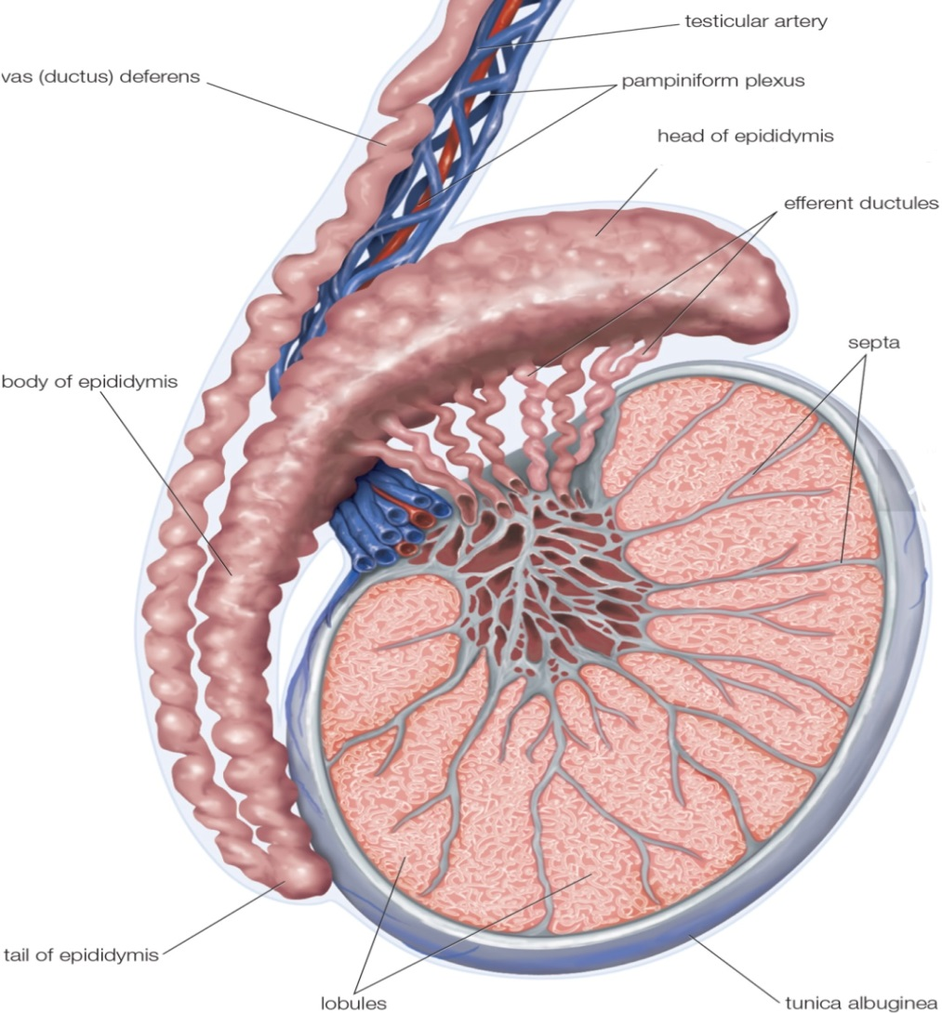
Testis and epididymis 1. Congenital anomalies 2. Regressive changes 3. Inflammation 4. Vascular disorders 5. Testicular tumors

Slide 17
1. Cryptochidism .It refers to incomplete descent of the testis from the abdomen to the scrotum and is present in about 1 % of 1-year old male infants. .Bilateral, sometimes unilateral is associated with tubular atrophy and sterility. .It carries 3-5 folds higher risk of testicular cancer.

Slide 18
Morphology .Gross: the cryptochid testis apears to be small and firm. .Histopathology: - arrested germ cell development - marked hyalinization and thickening of the basement membrane of the spermatic tubules.

Slide 19
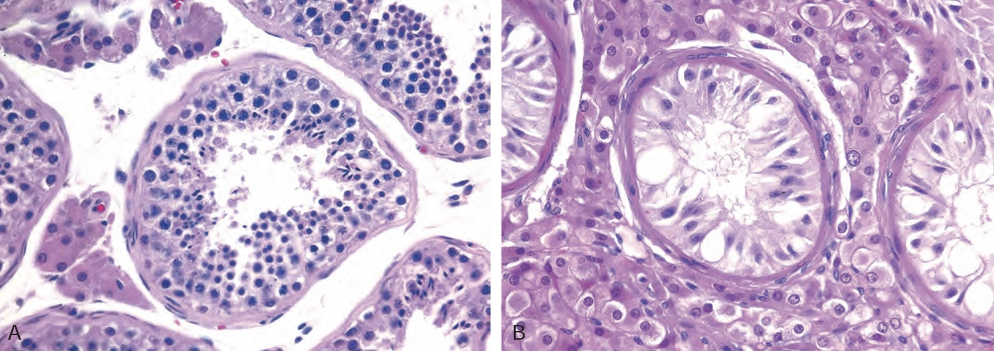
A: Normal testis B: Testicular atrophy in cryptochidism

Slide 20
2.Regressive changes Atrophy and decreased fertility: may be caused by one of the following conditions: 1. Atherosclerotic narrowing of blood supply 2. The end stage of an inflammatory orchitis 3. Cryptochidism 4. Hypopituitarism 5. Malnutrition or cachexia 6. Irradiation 7. Prolonged adminstration of antiandrogens

Slide 21
3.Inflammation .More common in epididymis than in the testis, of 2 types A: Nonspecific : commonly related to urinary tract infections (cystitis, urethritis ,prostatitis) Morphology : non specific acute inflammation characterized by congestion, edema, infiltration of neutrophils ,lymphocytes and macrophages, it may progress to abscess formation.

Slide 22
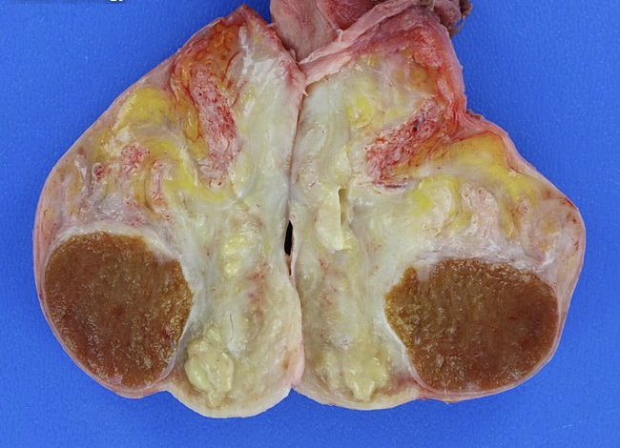
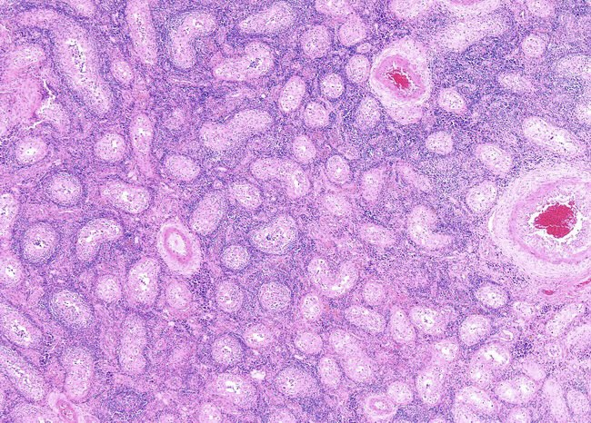
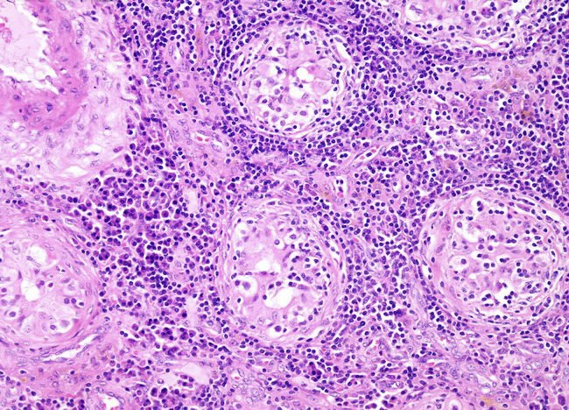
Acute epididymo-orchitis

Slide 23
B: Specific inflammations : - Gonorrhea -Mumps -Tuberculosis -Syphilis

Slide 24
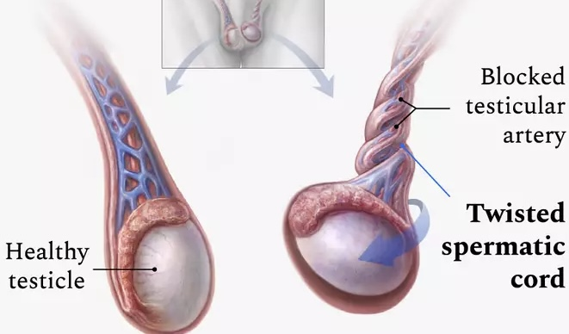
4. Testicular torsion . A surgical emergency due to twisting of spermatic cord that cuts off the venous drainage of the testis. . If untreated , it leads to testicular infarction.

Slide 25
. Morphology : - range from intense congestion to widespread hemorrhage to testicular infarction. - advanced stages: soft, necrotic , hemorrhagic tissue

Slide 26
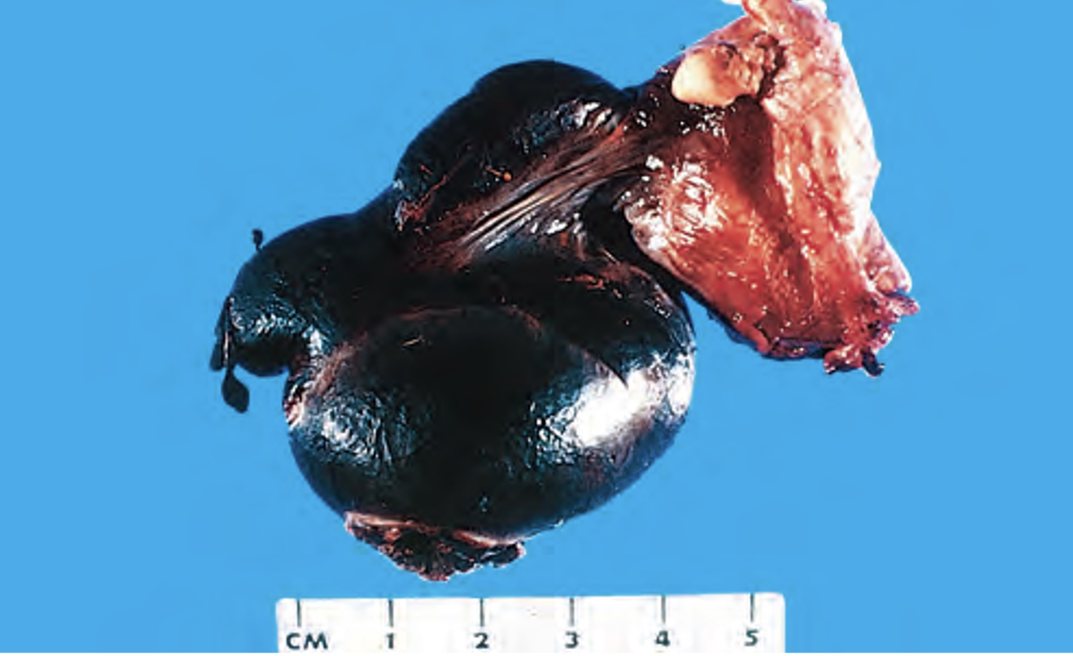
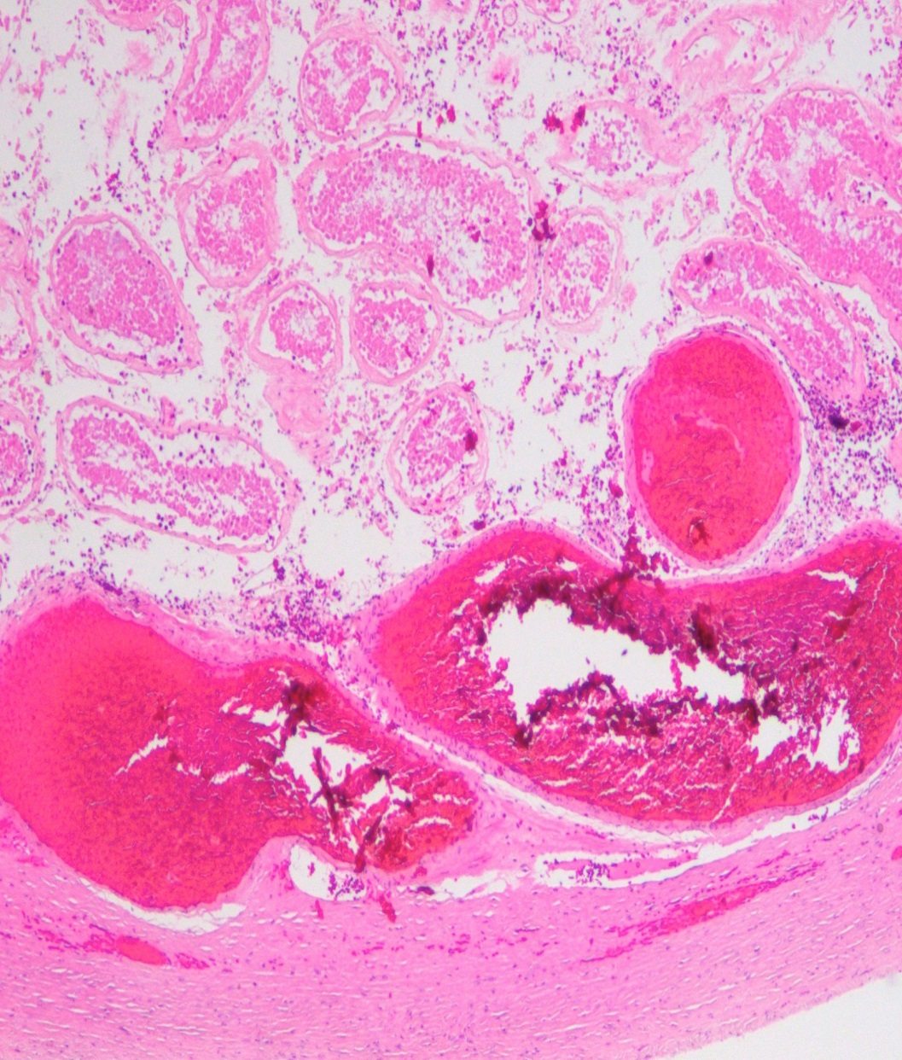
Testicular torsion

Slide 27
5.Testicular tumors .They are the most common cause of painless testicular enlargement. .They occur with increased frequency in association with undescended testis and testicular dysgenesis. . Germ cells are the source of 95% of all testicular tumors, 60 % of them is of single histological subtype , and 40 % are of mixed patterns.

Slide 28
WHO classification of testicular tumors 1. Germ cell tumors(GCT) (95%): A: GCT derived from germ cell neoplasia in situ (GCNIS) → Seminomatous tumors (Seminoma) → Non-seminomatous . Embryonal carcinoma . Choriocarcinoma . Yolk sac tumor(postpubertal) . Teratoma (postpubertal) B: GCT unrelated to GCNIS: . Spermatocytic tumor pre-pubertal)) . Teratoma pre-pubertal) ) . Yolk sac tumor 2.Sex- cord stromal tumors (5%) . Leydig cell tumor . Sertoli cell tumor

Slide 29
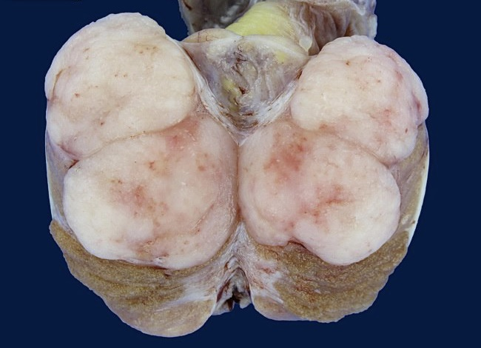
Seminoma . It is the most common type of GCT (50%) . The peak incidence is the third decade. . Remain confined to the testis for a long time. Gross : Well –demarcated bulky masse of homogenous white gray lobulated cut surface, usually devoid of hemorrhage and necrosis.

Slide 30
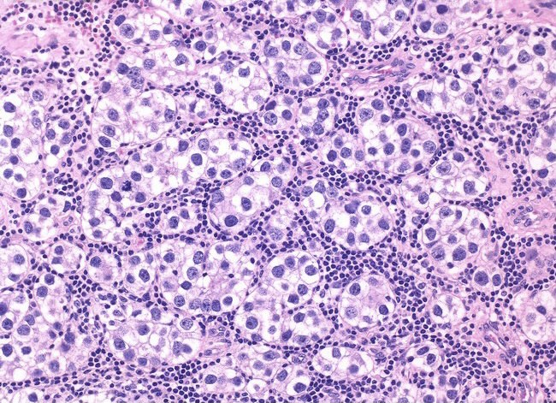
Microscopically: Sheets of uniform cells separated by delicate fibrous septa that is heavily infiltrated by lymphocytes ,the cells are large , with distinct cell membrane, clear cytoplasm with large central pale nucleus and a prominent nucleolus.

Slide 31
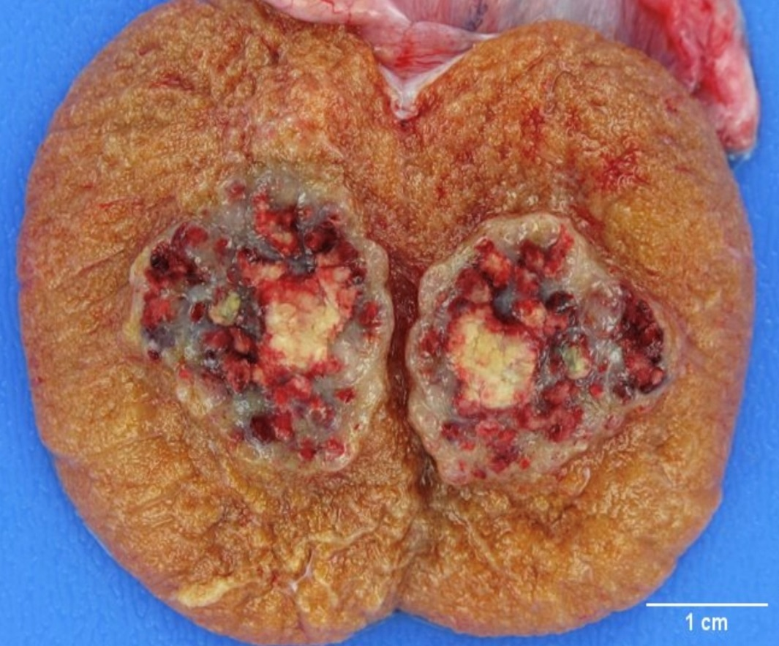
Embryonal carcinoma .Occur mostly in 20-30 year age group .More aggressive than seminoma with earlier spread Gross : Poorly demarcated margins, smaller than seminoma , variegated surface and often have necrosis and hemorrhage.

Slide 32
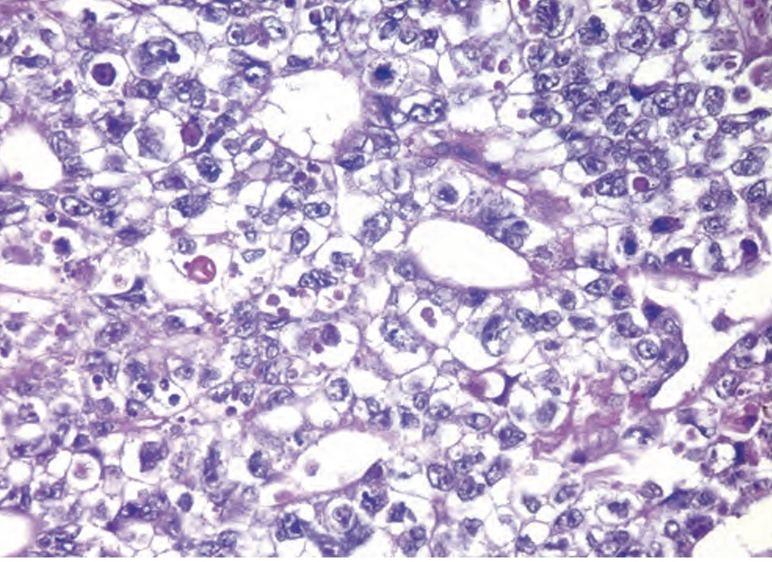
Microscopically: The cells grow in alveolar or tubular pattern, well formed glands are absent , the cells are large hyperchromatic with prominent nucleoli , and exhibit prominent variation in size and shape

Slide 33
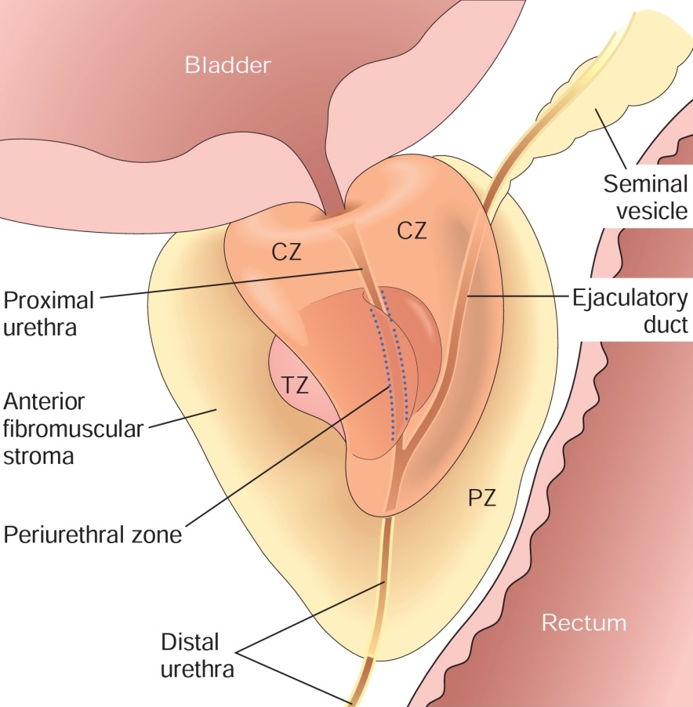
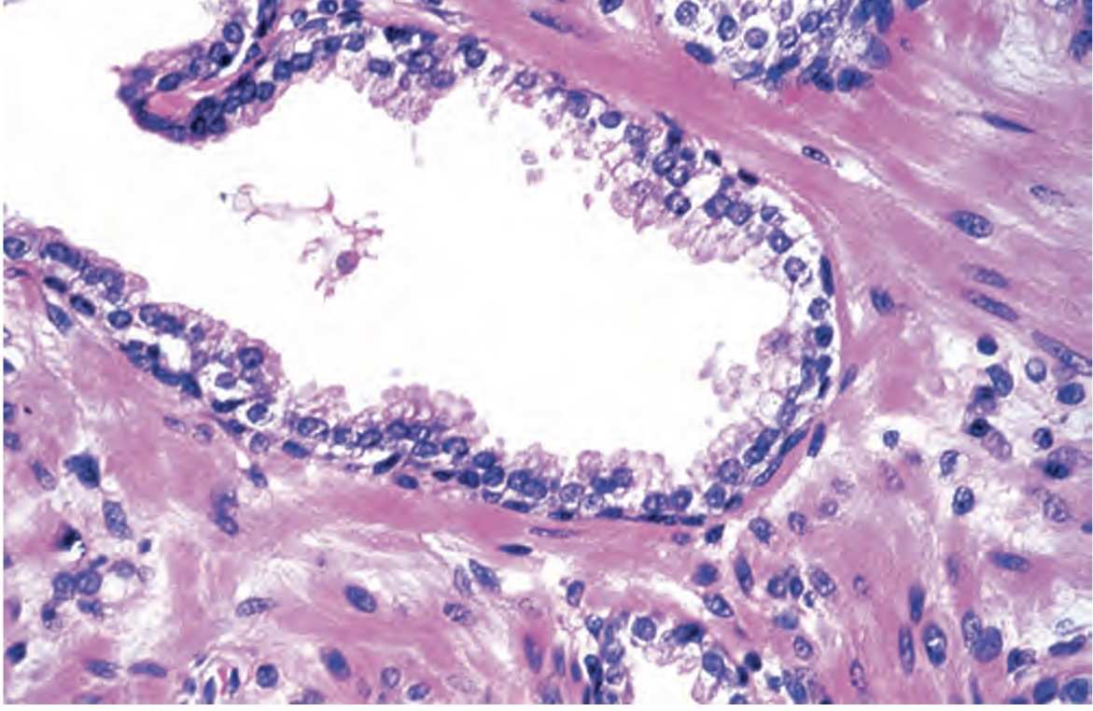
Prostate . In the normal adult , the prostate gland weighs about 20 gm .It s a retroperitoneal organ encircling the bladder neck and urethra.

Slide 34
Inflammation .Prostatitis is divided into several categories : 1. Acute bacterial prostatitis 2. Chronic bacterial prostatitis 3. Chronic abacterial prostatitis 4.Granulomatous prostatitis

Slide 35
Benign prostatic hyperplasia(nodular hyperplasia) . BPH is the most common benign prostatic disease in men older than 50 years. . It result from nodular hyperplasia of prostatic stromal and epithelial cells resulting in urinary obstruction.

Slide 36
. DHT (dihydrotestosterone) ,is an androgen derived from testosterone , is the major stimulus for the proliferation. . It most commonly involve the periurethral zone of the prostate, producing nodules that compress the urethra. . Clinical features apear only in 10% of affected patients and they involve hesitancy , urgency , nocturia.

Slide 37
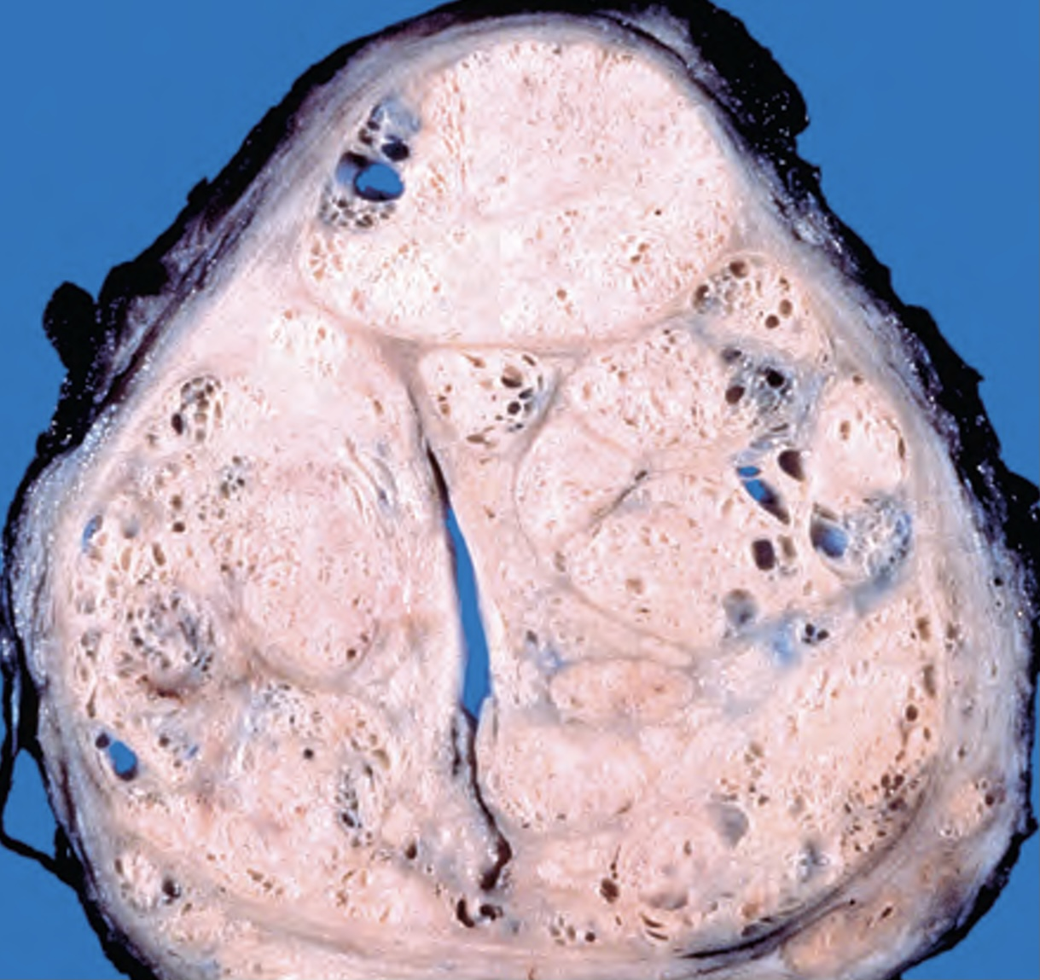
Morphology Grossly: prostate show well defined nodules compress the urethra, the nodules vary in color and consistency( soft yellowish pink to pale grey and tough).

Slide 38
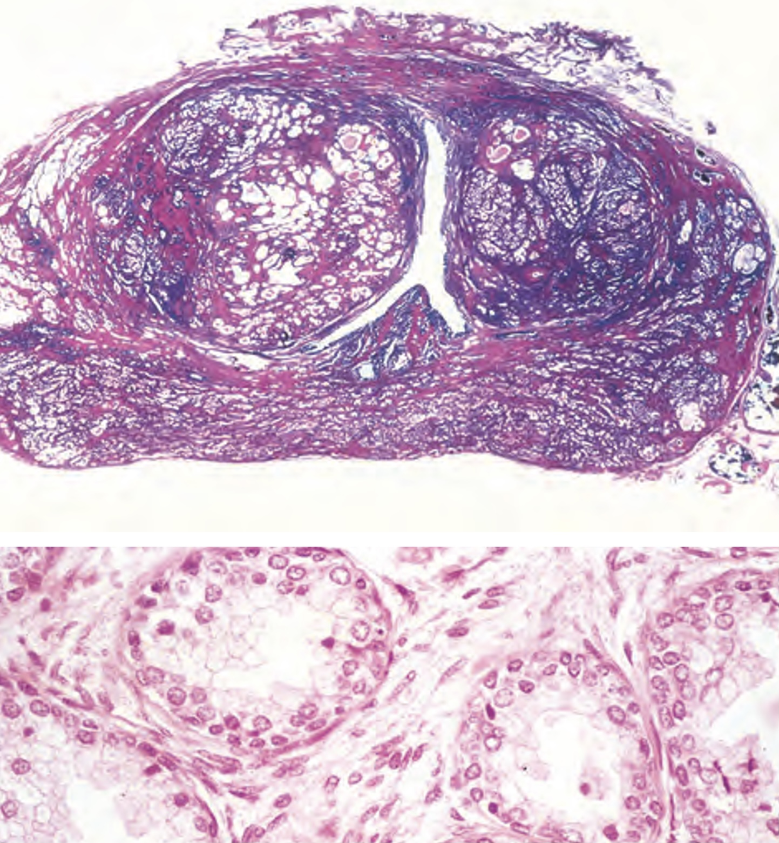
Microscopically: Glandular proliferation of small- large- cystically dilated glands lined by two layers of cells an inner columnar and outer cuboidal-flat

Slide 39
Tumors .Adenocarcinoma of the prostate is the most common form of cancer in men. .It is typically a disease of older men (65-75years) .Its uncommon in asian and more common among blacks. .Age, race, family history , hormone levels and enviromental factors are suspected to play a role

Slide 40
.Androgen play an important factor in prostate cancer .They range from indolent lesions to clinically aggressive tumors .It most commonly (70 %of cases) involve the outer peripheral zone .The prostatic adenocarcinoma usually refers to the most common acinar variant

Slide 41
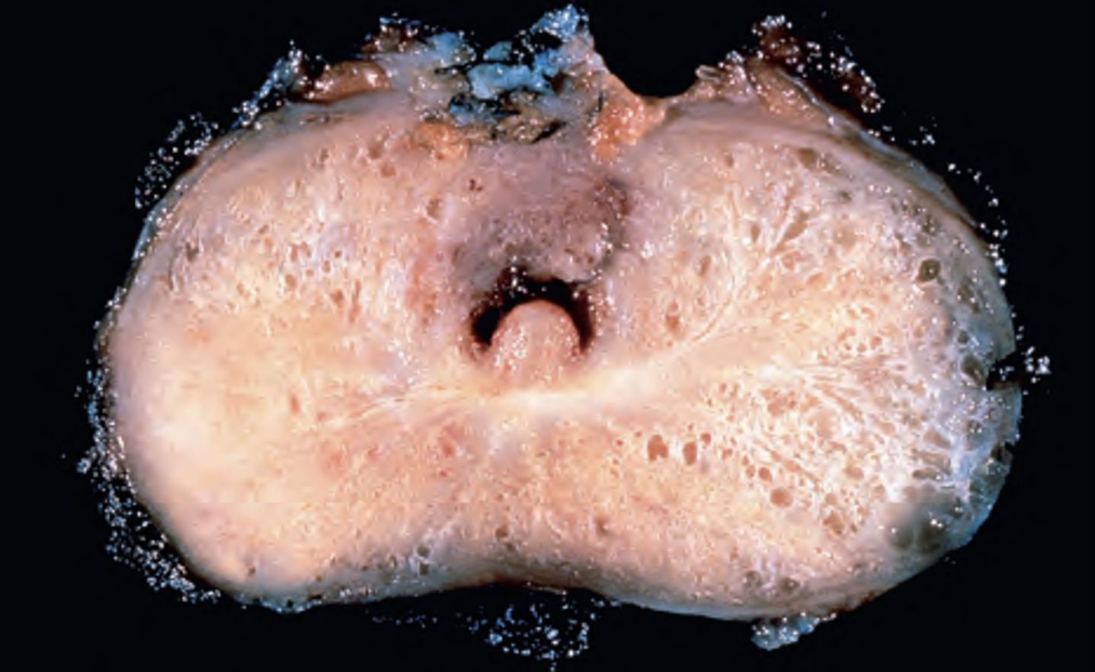
Morphology Grossly: Neoplastic tissue is gritty and firm

Slide 42
Microscopically: .Most lesions are adenocarcinomas that produce well defined gland patterns, the neoplastic glands are typically smaller, more crowded and lack branching when compared to normal glands. .The glands are lined by single layer of cuboidal-low columnar epithelium .The cytoplasm is pale-amphophilic, nuclei are large with one or more prominent nucleoli.

Slide 43
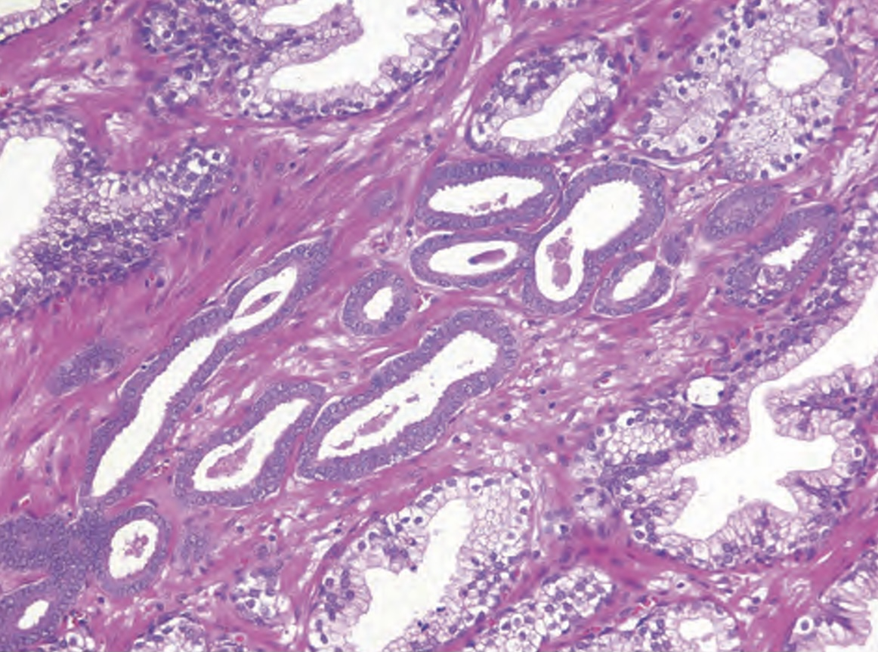
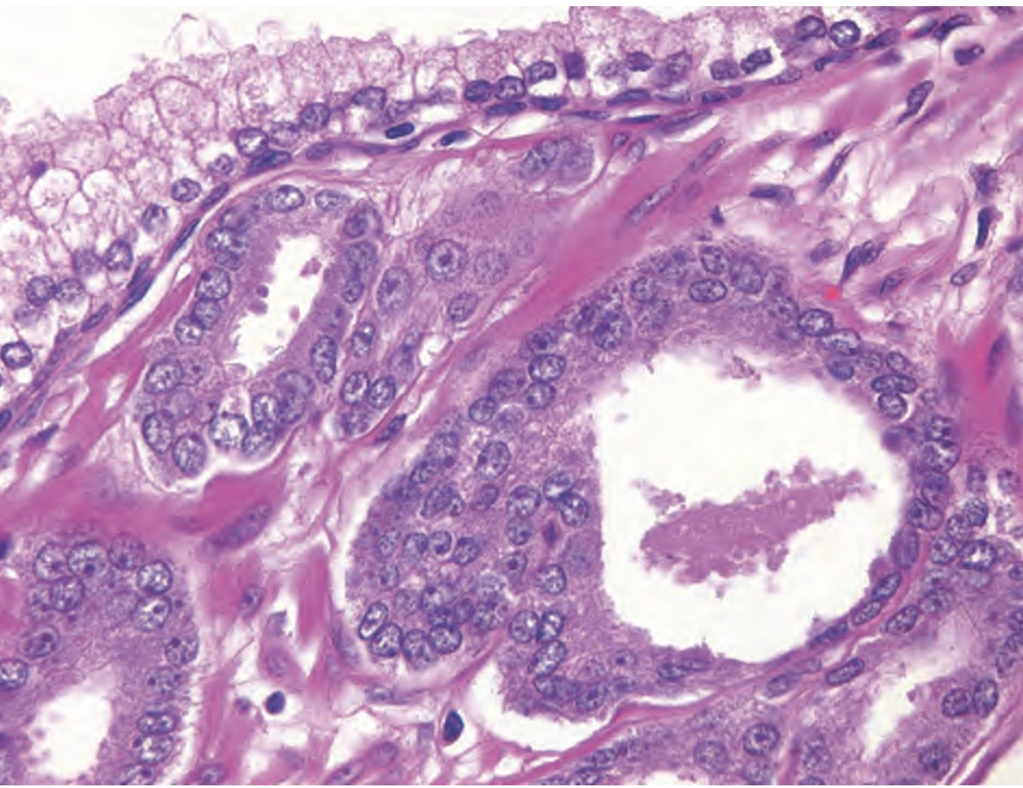
Prostatic adenocarcinoma

Slide 44
.80% of prostatic adenocarcinoma is associated with prostatic intraepithelial neoplasia (PIN) .Local extension of prostate carcinoma is to periprostatic tissue,seminal vesicles and the base of urinary bladder. .Lypmphatic spread is to the regional lymph nodes. .Hematogenous spread occurs cheifly to the bones ,especially the axial skeleton and typically osteoblastic.

Slide 45
.Grading of prostatic cancer is by the Gleason grading system which correlate with the pathological stage and prognosis. .Measurement of serum prostatic specific antigen (PSA) is widely used to assist with the diagnosis and management of prostatic carcinoma.

Slide 46
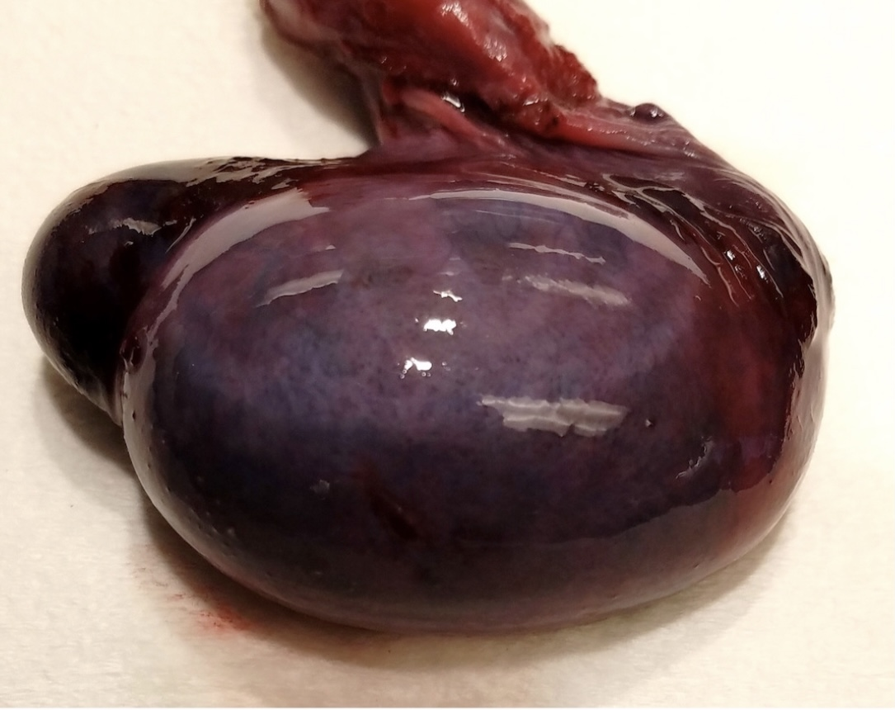
Q1: A 22 years old man, presented to the emergency department with sudden onset of sever testicular pain for the past 5 hours, on physical examination he is afebrile, with extreme tenderness of the slightly enlarged left testis , no other remarkable findings. Gross examination of the left testis is shown in the figure below, what is the most likely cause for this condition: 1.Seminoma 2.Bacterial infection 3.Lymphatic obstruction 4.Blood flow obstruction 5.Previous surgery

Slide 47
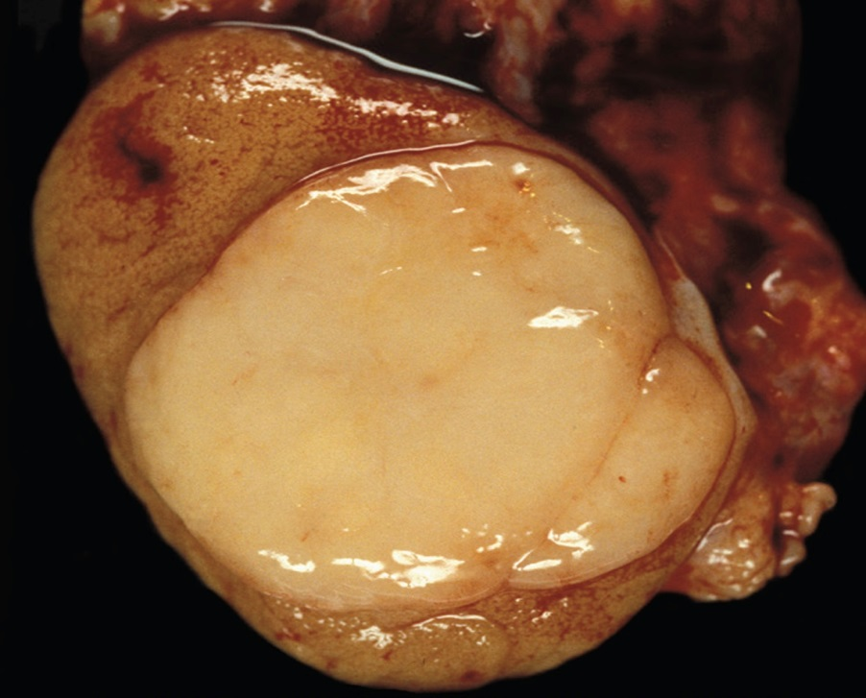
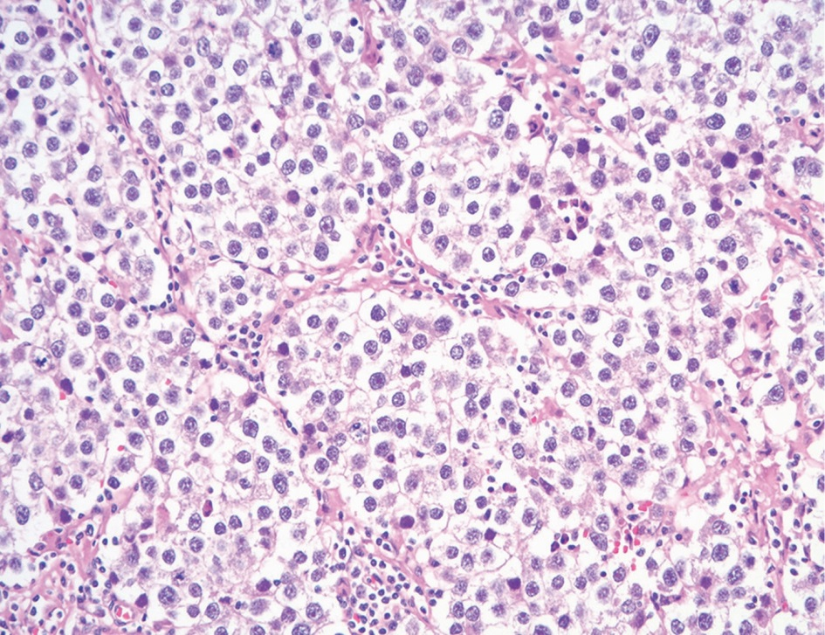
Q2: A 27 years old man , presented with right testicular enlargement and dull pain over the last few months , on examination, the right testis is slightly enlarged , ultrasound scan showed a well defined 2 cm solid mass in the right testis, the gross and microscopic appearance of the mass is shown below, what is the possible diagnosis of this lesion?

Slide 48
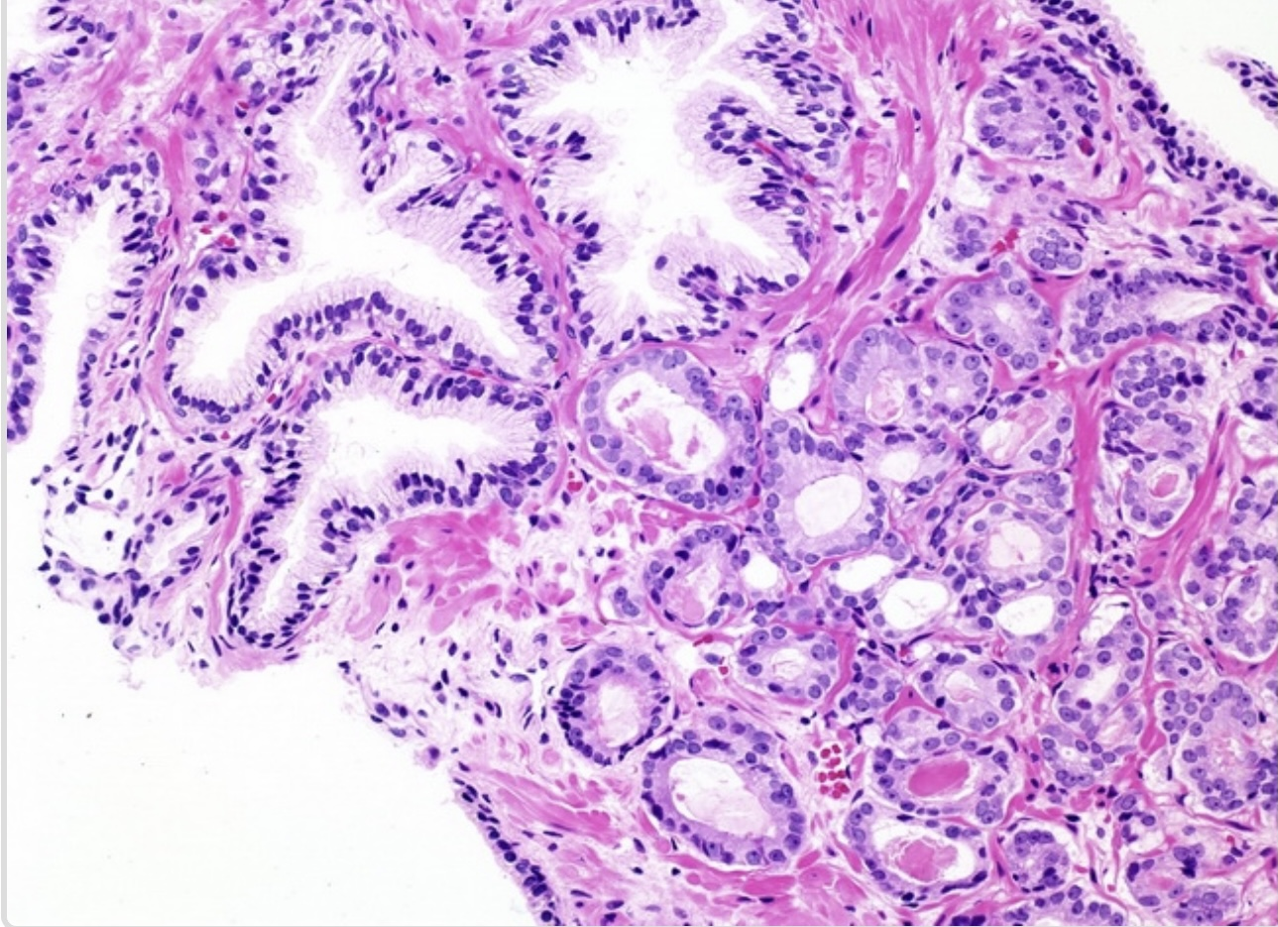
Q3: A 68 years old man , came for the routine health maintenance examination ,laboratory finding showed a PSA level of 16 ng/mL , prostatic biopsy was performed and the microscopic picture is shown in the image below, what is the possible diagnosis from the following finding? 1. Acute prostatitis 2.Chronic prostatitis 3.BPH 4. Adenocarcinoma

Slide 49
Thank you

